Slide 1
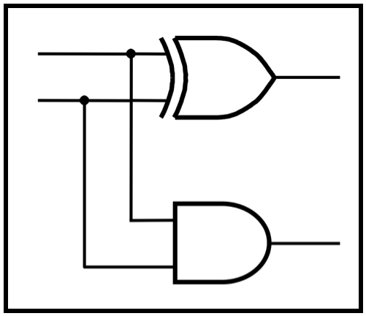
CprE 281:
Digital Logic
Instructor: Alexander Stoytchev
http://www.ece.iastate.edu/~alexs/classes/

Slide 2
Logic Gates
CprE 281: Digital Logic
Iowa State University, Ames, IA
Copyright © Alexander Stoytchev

Slide 3
Administrative Stuff
HW1 is out
It is due on Monday Aug 29 @ 4pm.
Submit it on paper before the start of the lecture
Please write clearly on the first page:
  your name
  student ID
  lab section letter

Slide 4
Labs Next Week
Please download and read the lab assignment for next week before you go to your lab section.
You must print the answer sheet and do the prelab before you go to the lab.
The TAs will check your prelab answers at the beginning of the recitation. If you don't have it done you'll lose 20% of the lab grade for that lab.

Slide 6
A Binary Switch
x
=
0
x
=
1
(a) Two states of a switch
S
x
(b) Symbol for a switch
[ Figure 2.1 from the textbook ]

Slide 7
A Light Controlled by a Switch
S
Battery
x
Light
(a) Simple connection to a battery
[ Figure 2.2a from the textbook ]

Slide 8
A Light Controlled by a Switch
S
Power
supply
x
Light
(b) Using a ground connection as the return path
[ Figure 2.2b from the textbook ]

Slide 9
The Logical AND function
(series connection of the switches)
S
S
Power
x₁
x₂
supply
Light
[ Figure 2.3a from the textbook ]

Slide 10
The Logical OR function
(parallel connection of the switches)
S
x₁
Power
Light
supply
S
x₂
[ Figure 2.3b from the textbook ]

Slide 11
A series-parallel connection
of the switches
S
X₁
S
Power
X₃
Light
supply
S
X₂
[ Figure 2.4 from the textbook ]

Slide 12
An Inverting Circuit
R
Power
supply
x
S
Light
[ Figure 2.5 from the textbook ]

Slide 13
The Three Basic Logic Gates
x
1
x
⋅
x
1
x
x
1
x
2
x
1
+
x
2
x
2
x
2
NOT gate
AND gate
OR gate
[ Figure 2.8 from the textbook ]

Slide 14
Truth Table for NOT
x
x
x
x
0
1
1
0

Slide 15
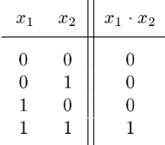
Truth Table for AND
x
1
x
⋅
1
x
2
x
2

Slide 16
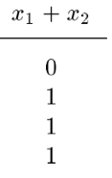
Truth Table for OR
x
1
x
x
1
+
x
2
2

Slide 17








Truth Tables for AND and OR
[ Figure 2.6b from the textbook ]

Slide 18
Logic Gates with n Inputs
x
1
x
x
1
2
x
2
x
⋅
⋅
…
⋅
1
x
2
x
n
x
+
x
+
…
+
x
1
2
n
x
n
x
n
AND gate
OR gate
[ Figure 2.8 from the textbook ]

Slide 19
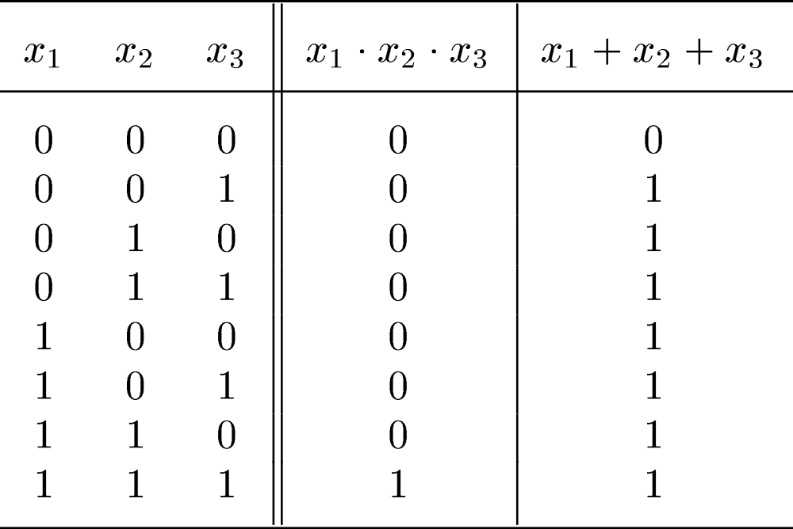
Truth Table for 3-input AND and OR
[ Figure 2.7 from the textbook ]

Slide 20
Example of a Logic Circuit
Implemented with Logic Gates
x
1
x
2
f
=
(
x
1
+
x
2
)
⋅
x
3
x
3
[ Figure 2.8 from the textbook ]

Slide 21
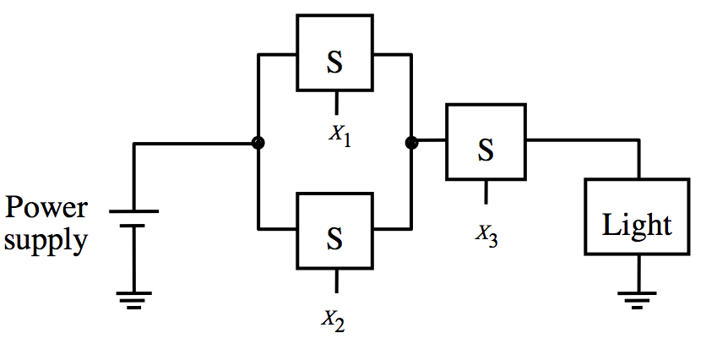
Example of a Logic Circuit
Implemented with Logic Gates
x
1
x
2
f
=
(
x
1
+
x
2
)
⋅
x
3
x
3
[ Figure 2.8 from the textbook ]

Slide 22
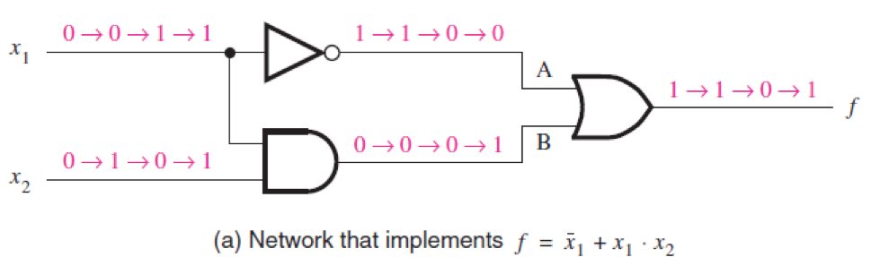
Network Analysis
[ Figure 2.10 from the textbook ]

Slide 23
Network Analysis
[ Figure 2.10 from the textbook ]

Slide 24
Network Analysis
[ Figure 2.10 from the textbook ]

Slide 25
Network Analysis
[ Figure 2.10 from the textbook ]

Slide 26
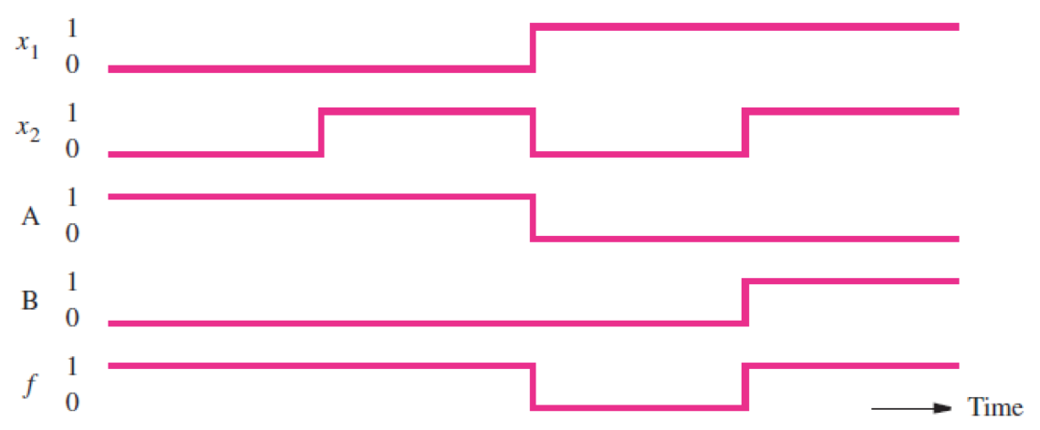
Network Analysis
[ Figure 2.10 from the textbook ]

Slide 27
Timing Diagram
[ Figure 2.10 from the textbook ]

Slide 28
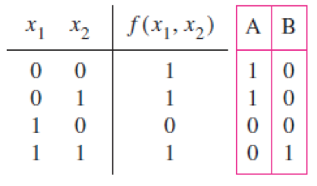
Truth Table for this Network
[ Figure 2.10 from the textbook ]

Slide 29
Functionally Equivalent Networks
[ Figure 2.10 from the textbook ]

Slide 30
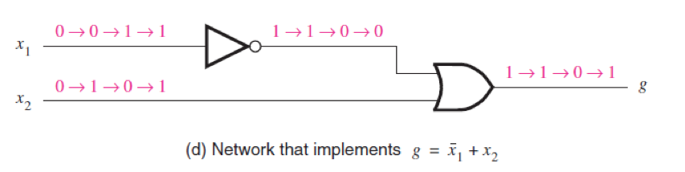
Functionally Equivalent Networks
[ Figure 2.10 from the textbook ]

Slide 31
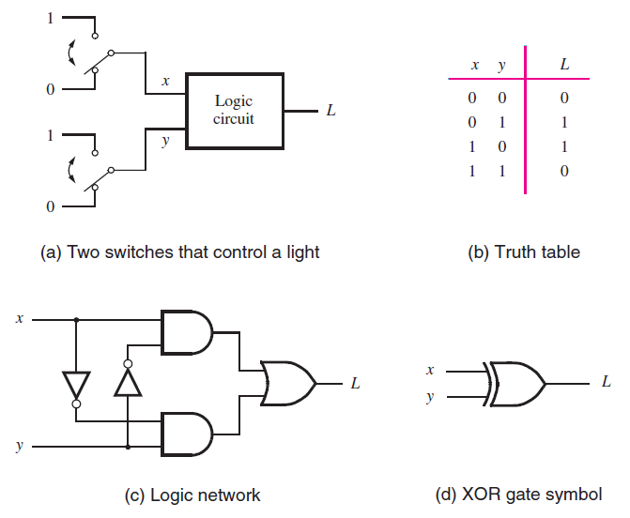
The XOR Logic Gate
[ Figure 2.11 from the textbook ]

Slide 32
The XOR Logic Gate
[ Figure 2.11 from the textbook ]

Slide 33
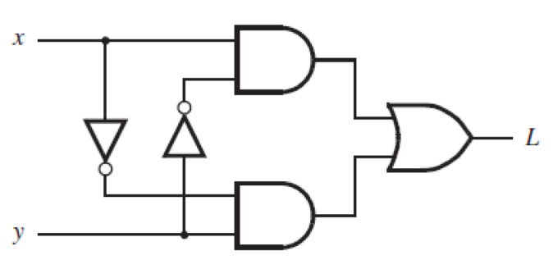
XOR Analysis
[ Figure 2.11c from the textbook ]

Slide 34
XOR Analysis (x=0, y=0)
0
0

Slide 35
XOR Analysis (x=0, y=0)
0
0
0
0

Slide 36
XOR Analysis (x=0, y=0)
0
0
1
1
0
0

Slide 37
XOR Analysis (x=0, y=0)
0
0
1
0
1
0
0
0

Slide 38
XOR Analysis (x=0, y=0)
0
0
1
0
0
1
0
0
0

Slide 39
XOR Analysis (x=0, y=1)
0
0
0
0
1
1
1
1
1

Slide 40
XOR Analysis (x=1, y=0)
1
1
1
1
1
0
0
0
0

Slide 41
XOR Analysis (x=1, y=1)
1
1
0
0
0
0
0
1
1

Slide 42
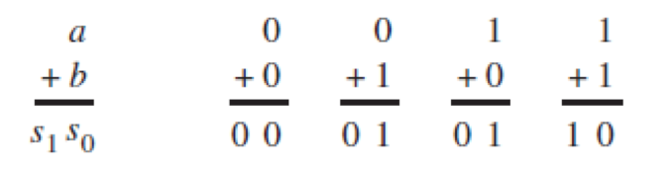
Addition of Binary Numbers
[ Figure 2.12 from the textbook ]

Slide 43
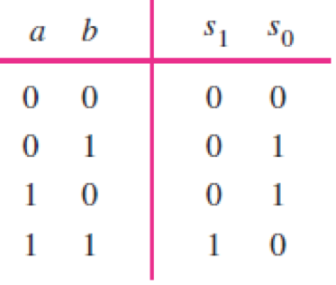
Addition of Binary Numbers
[ Figure 2.12 from the textbook ]

Slide 44
Addition of Binary Numbers

Slide 45
Addition of Binary Numbers

Slide 46
Addition of Binary Numbers

Slide 47
Addition of Binary Numbers

Slide 48
Addition of Binary Numbers

Slide 49
Addition of Binary Numbers

Slide 50
Addition of Binary Numbers

Slide 51
Addition of Binary Numbers

Slide 52
Addition of Binary Numbers

Slide 53
Addition of Binary Numbers

Slide 54
Addition of Binary Numbers

Slide 55
Addition of Binary Numbers

Slide 56
Addition of Binary Numbers

Slide 57
Addition of Binary Numbers
?

Slide 58
Addition of Binary Numbers
AND

Slide 59
Addition of Binary Numbers

Slide 60
Addition of Binary Numbers
?

Slide 61
Addition of Binary Numbers
XOR

Slide 62
Addition of Binary Numbers

Slide 63
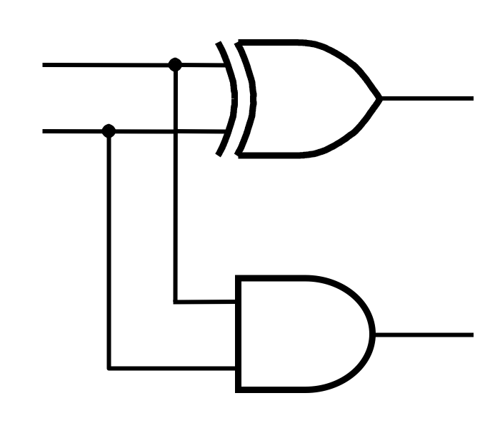
Addition of Binary Numbers

Slide 64
Addition of Binary Numbers
a
s₀
b
s₁

Slide 66
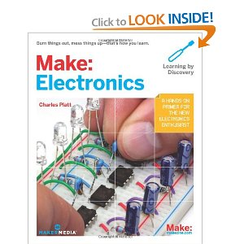
The following examples came from this book

Slide 67
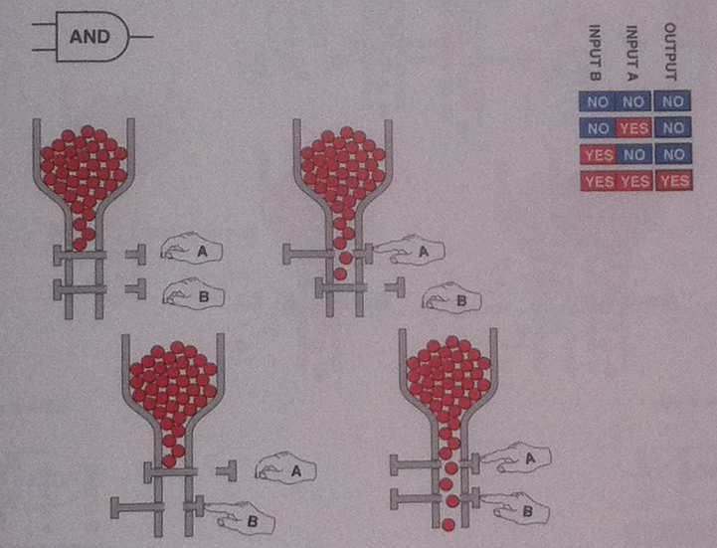
[ Platt 2009 ]

Slide 68
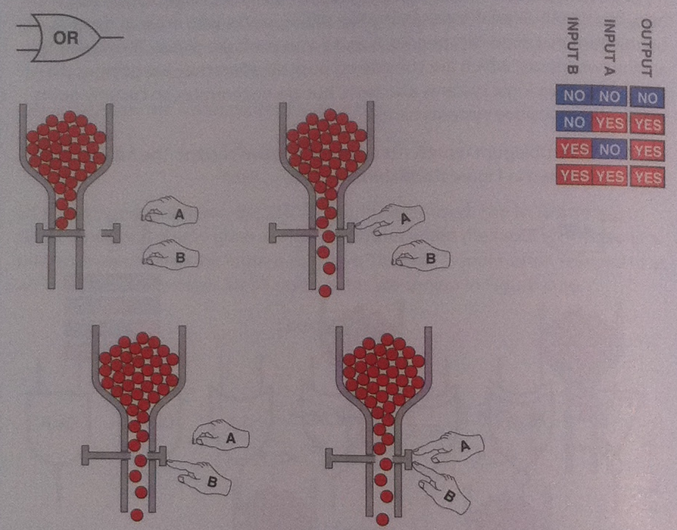
[ Platt 2009 ]

Slide 69
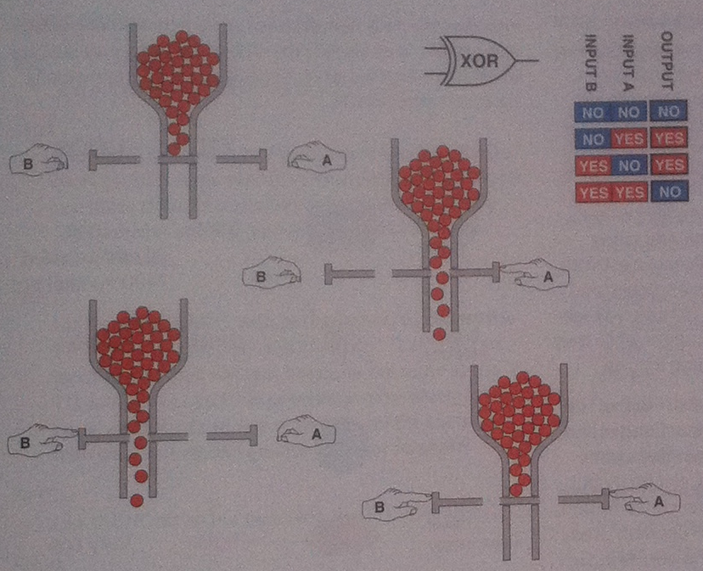
[ Platt 2009 ]

Slide 70
Questions?

Slide 71
THE END

